Slide 1

Asyraf Duyshart
Email : Asyraf@gapcer.co.id
Twitter : @asyrafduyshart
Medium : @Asyraf
Linkedn : Asyraf Duyshart
Phone : 082226662156

Slide 2
Minutes of my experiences
Working as Telco Designer
Starting a Company
Startup Life
2011
2013
2014
I will not code…
I should learn
how to code…
I should code…

Slide 3

Programming as a Designer
And how it affects my life & business
By Asyraf Duyshart, Project Director at Gapcer

Slide 4
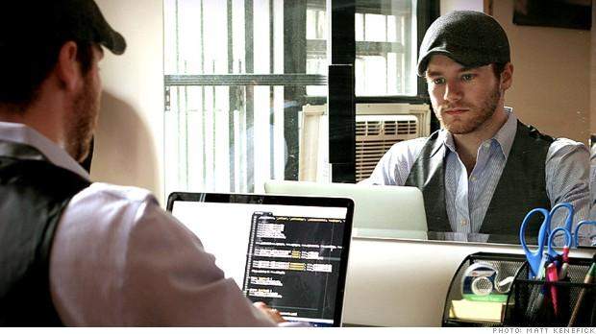
For years coding has been confined to engineer, programmer & developer.
So why we having this discussion right now?

Slide 5
Because not anymore.

Slide 6

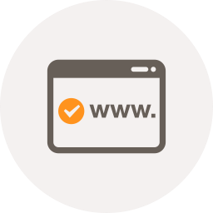


Growth of Digital Era
Code is the heart of digital business
Internet is rapidly growing
Code became easier to learn
Programming is for everyone

Slide 7
As a designers
Why should we?

Slide 8
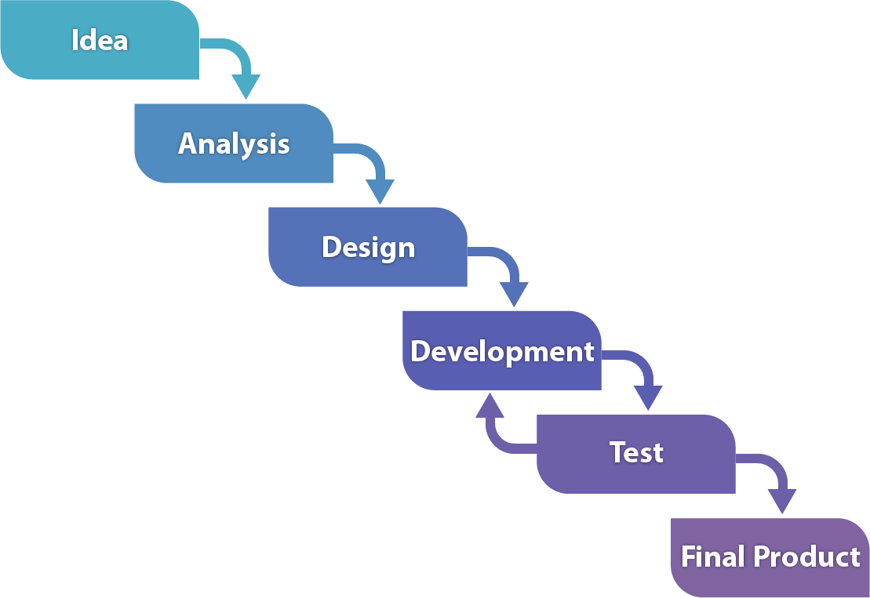
When building a product
Passing design over a wall of developers
Is always a trouble
Wall

Slide 9
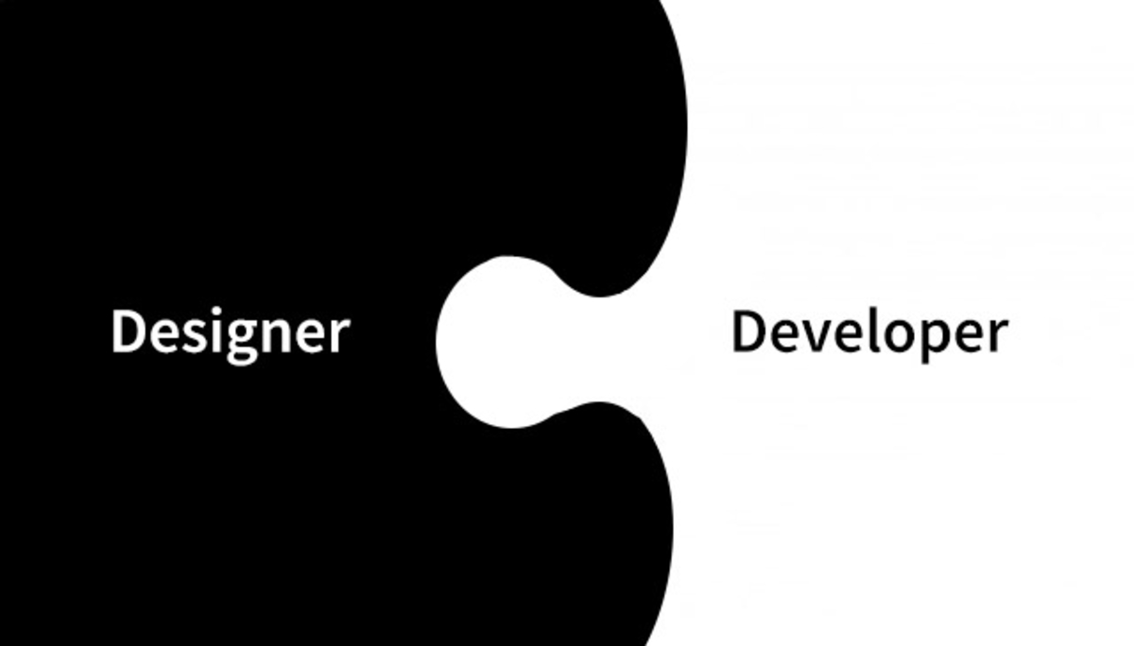

Slide 10
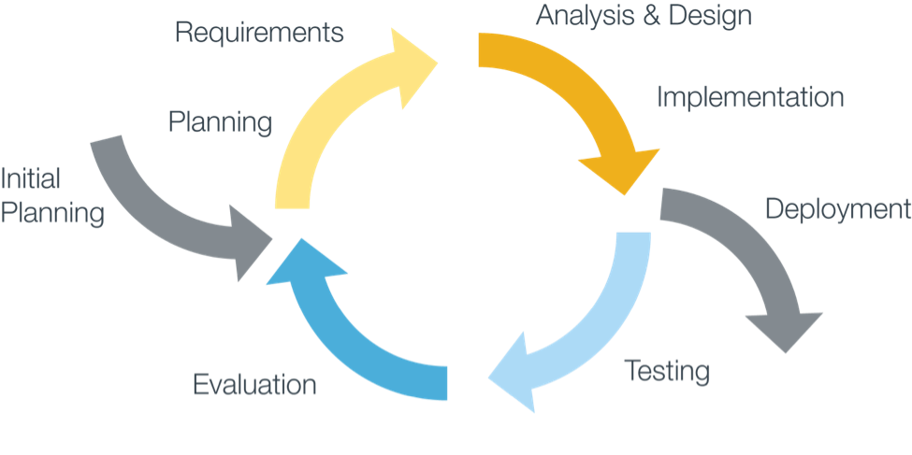

Slide 11
Learning to code does more than make me a more proficient Designer. It allows me move beyond the limited scope of paper and digital wireframes into the realm of…

Slide 12
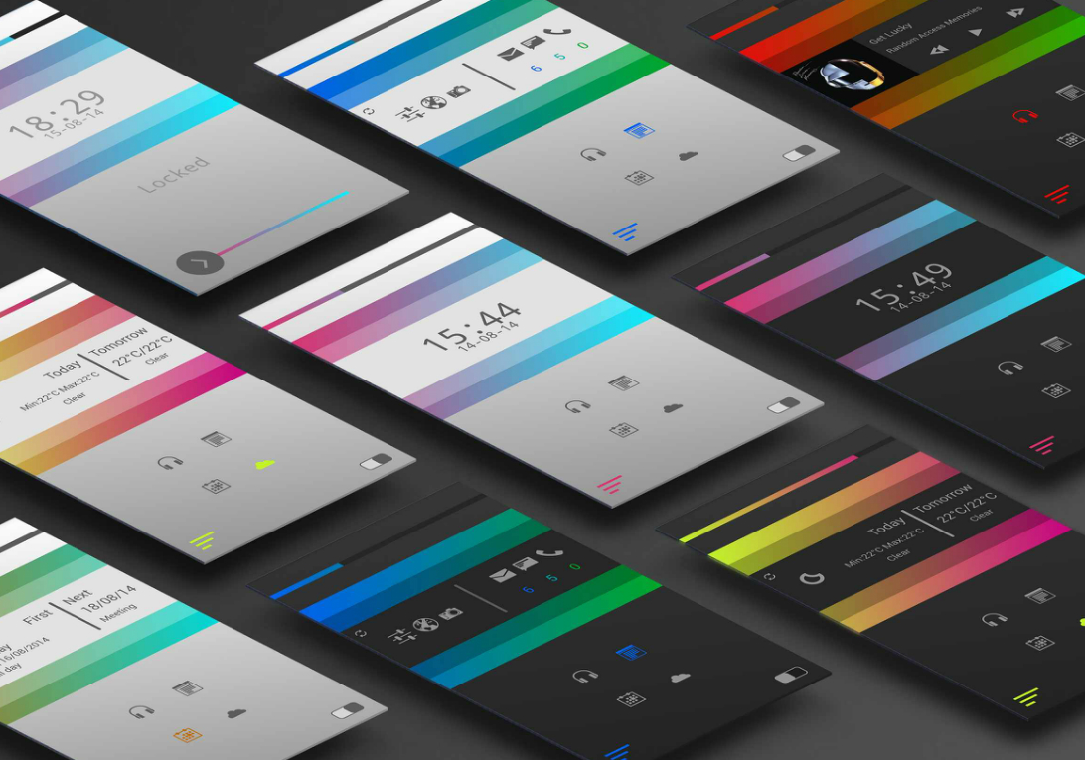
Rapid Prototyping

Slide 13
What’s the benefits for startup?
Fast Iteration

Slide 14
Knowing how to code greatly improves both my ability to communicate and the degree to which I can contribute and participate.

Slide 15


Summary
Programming is for everyone
Programming help designer communicate well with developers
Programming for designer help startup to built more fast & effective product

Slide 16
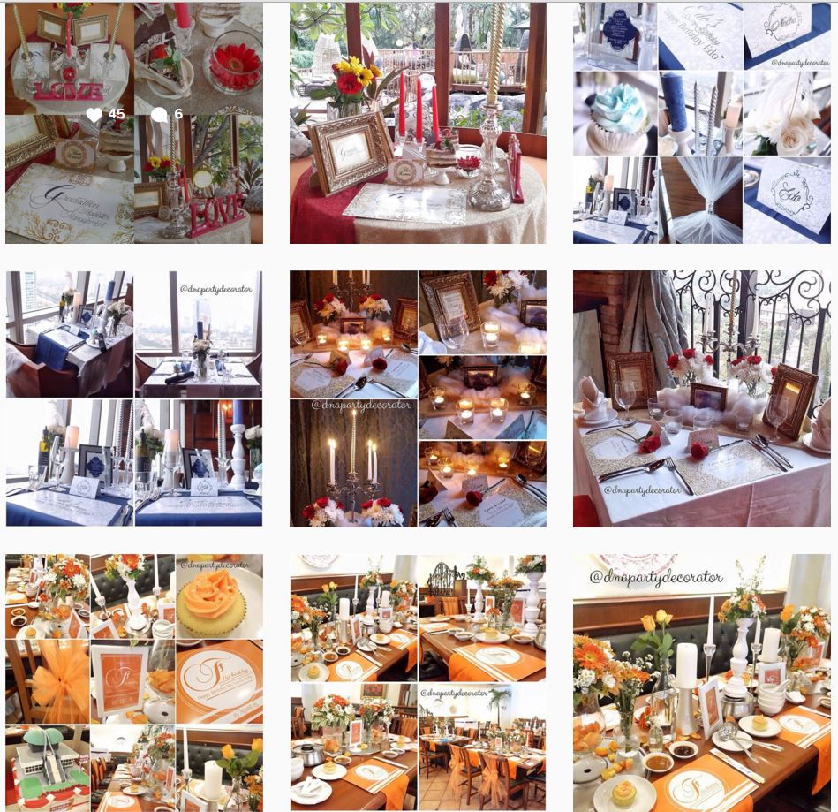

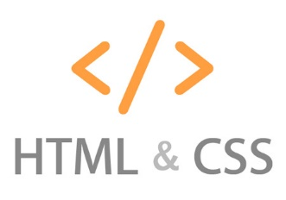
Study Case
+
Cut Adinda

Slide 17
Let’s Code

